Slide 1

English Premier League
The competition was founded as the FA Premier League on 20 February 1992 following the decision of clubs in the Football League First Division to break away from the Football League, founded in 1888
The Premier League is the most-watched sports league in the world, broadcast in 212 territories to 643 million homes and a potential TV audience of 4.7 billion people.
There are 20 clubs in the Premier League. During the course of a season (from August to May) each club plays the others twice (a double round-robin system), once at their home stadium and once at that of their opponents', for 38 games

Slide 2
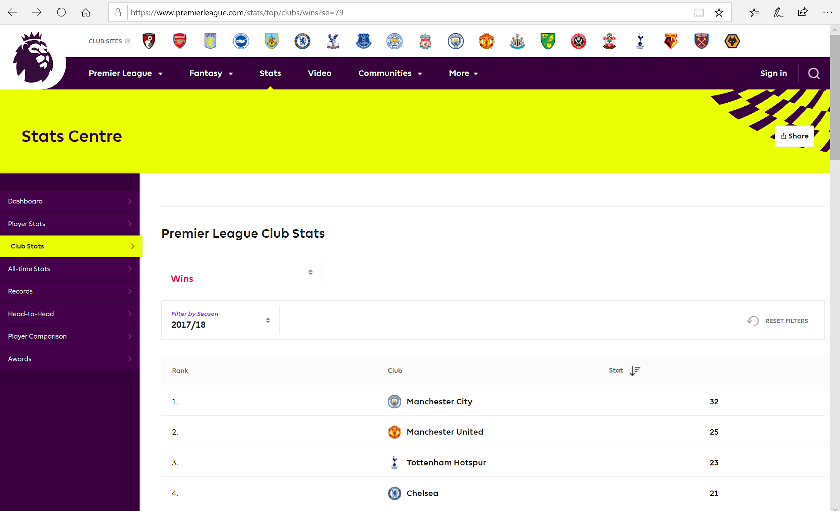
Website:
https://www.premierleague.com

Slide 3
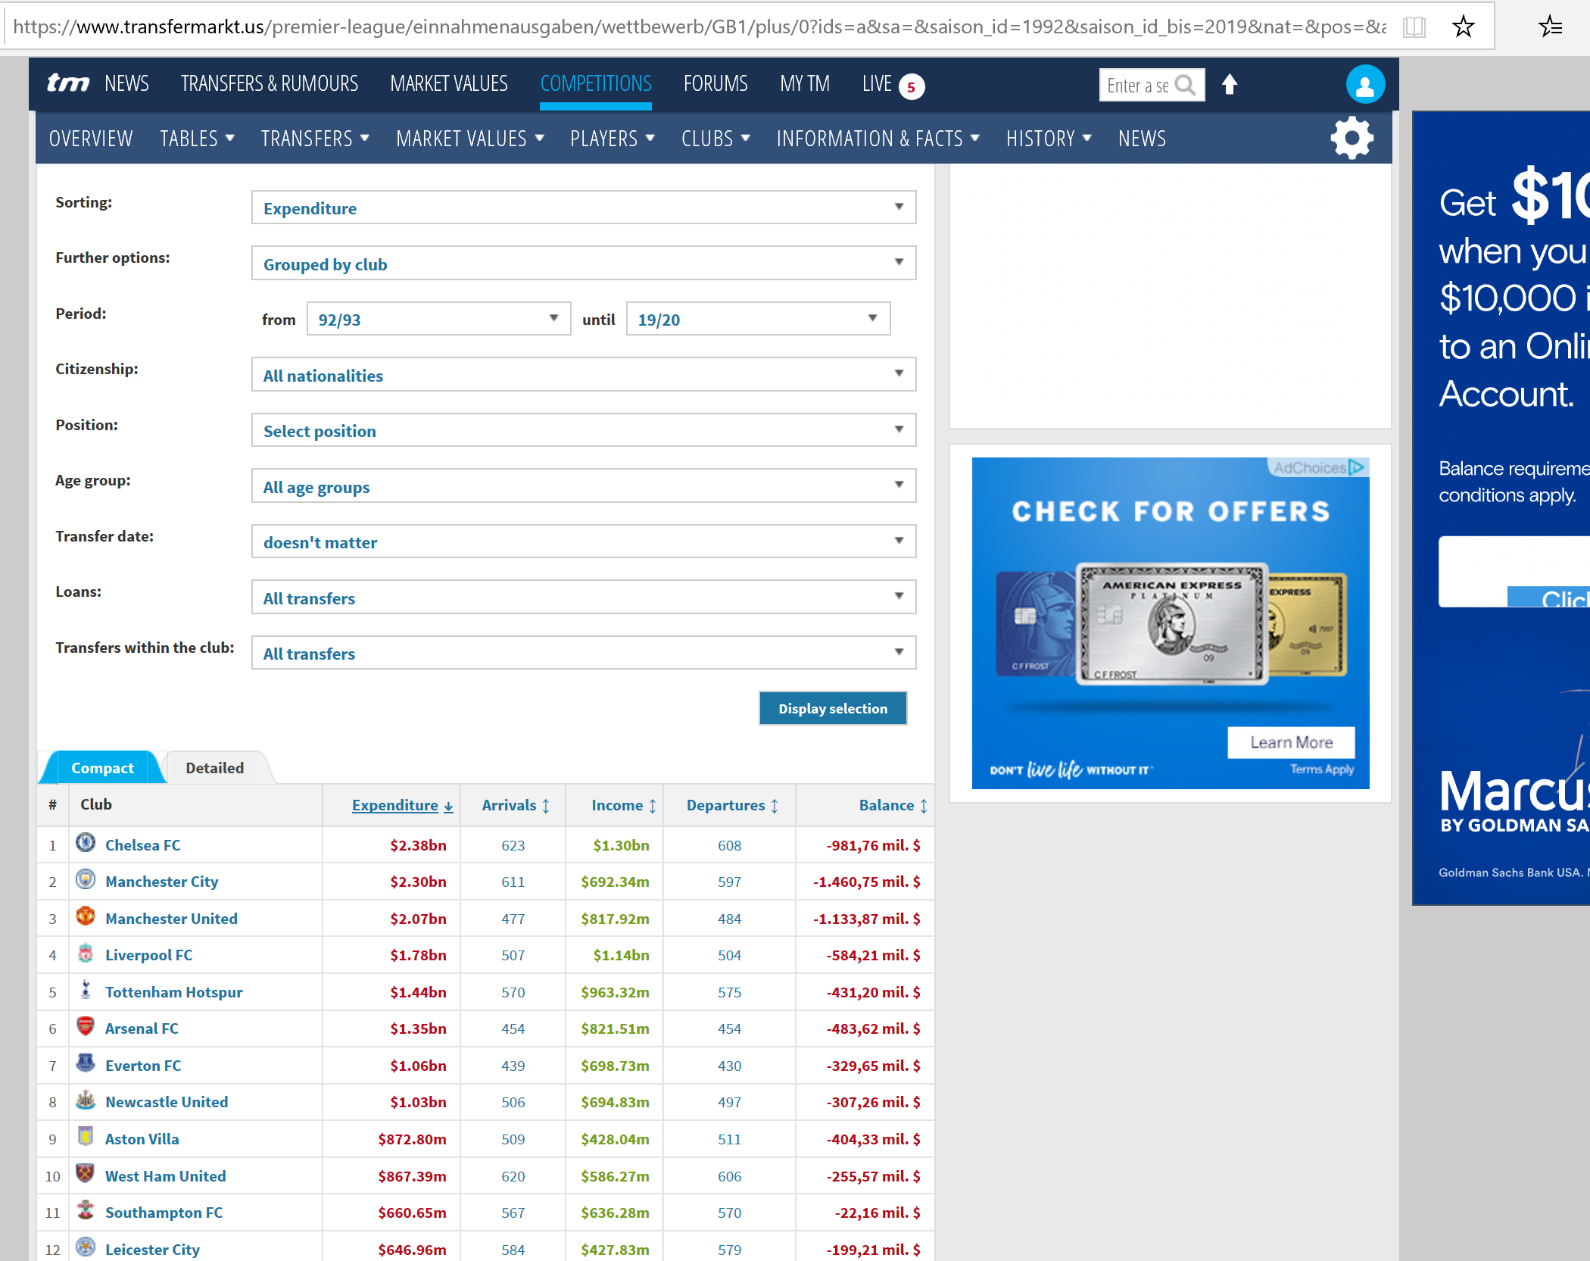
Website:
https://www.transfermarkt.us/premier-league

Slide 4
Questions
Any Correlation between money spent and winning or losing?
Can teams’ wins and losses be successfully predicted?
What are the key stats makes successful teams win?

Slide 5
Championship Titles
Manchester United = 13
Chelsea = 5
Manchester City = 4
Arsenal = 3
Blackburn Rovers = 1
Leicester = 1
Expenditure in Billions USD
Chelsea = $2.38
Man City = $2.30
Man United = $2.07
Liverpool = $1.78
Tottenham =$1.44
Arsenal $ = $1.35

Slide 6
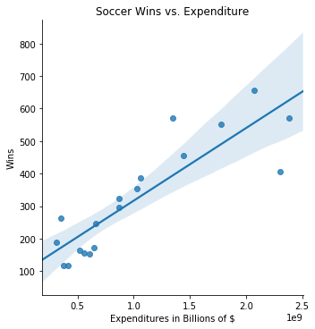
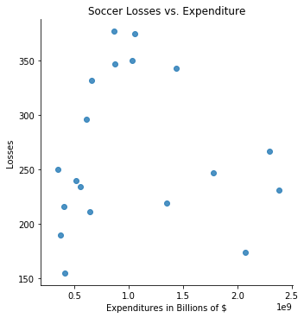
Correlation:
Expenditure vs Wins
Expenditure vs Losses

Slide 7
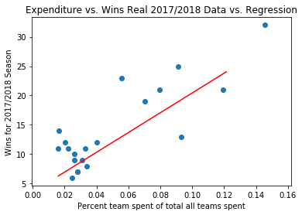
Can teams season be successfully predicted?

Slide 8
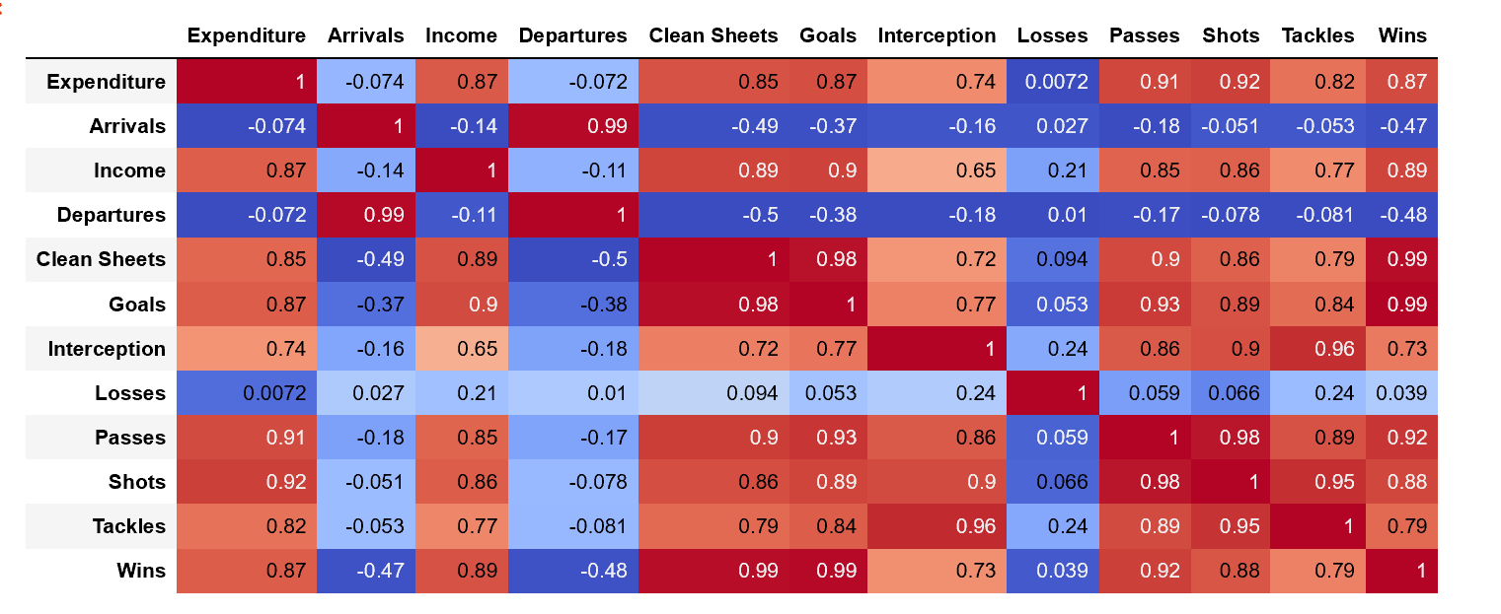
Keys to Success

Slide 9
Conclusion:
Spending money on high quality players will result in stats in goals, shots, clean sheets, tackles, and interceptions which has a high correlation with wins.

Slide 10
Additional Work:
What types of playing formation correlate with wins and losses?

